Slide 1
The Family
Peggy J. Miller
Department of Psychology
University of Illinois at Urbana-Champaign

Slide 2
Why is the family important?
The child’s first and longest lasting context for development
Families are universal
Human children take a long time to grow up
Human children need to be socialized

Slide 3
The Family: Outline
Systems perspective
Ecological perspective
Functions: socialization

Slide 4
Social systems perspective
Family = interdependent parts
  Relationships are BIDIRECTIONAL
  = mother affects child, child affects mother
  Relationships affected by 3rd PARTIES
  = other individuals in family affect quality of mother-child relationship

Slide 5
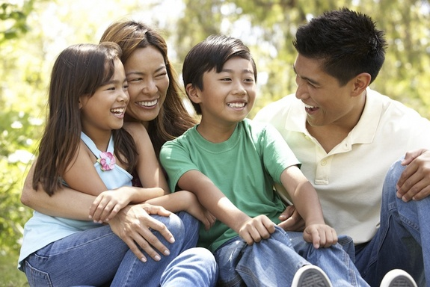
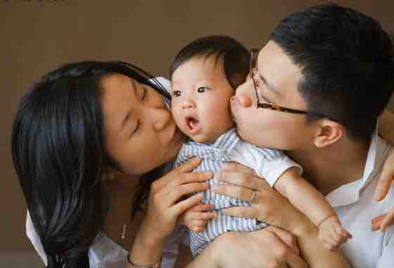
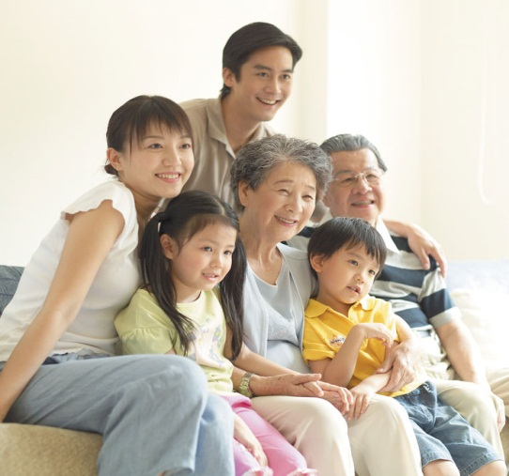
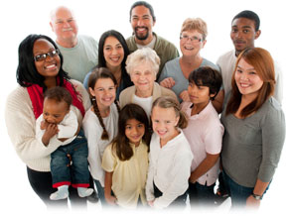
Family = interdependent parts

Slide 6
Social systems perspective
Family = interdependent parts
  Relationships are BIDIRECTIONAL
  Relationships affected by 3rd PARTIES
Families are dynamic
Families are embedded in larger contexts

Slide 7
Family as dynamic force in development
New events inside family
  Birth of sibling
  Enter school
Children develop
Parents develop
Changes from outside the family

Slide 8
Social systems perspective
Family = interdependent parts
  Relationships are BIDIRECTIONAL
  Relationships affected by 3rd PARTIES
Families are dynamic
Families are embedded in larger contexts:
  “Ecological Systems Theory”

Slide 9
The Family: Outline
Systems perspective
Ecological perspective
Functions: socialization

Slide 10
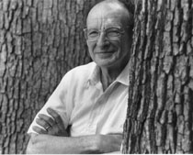
Ecological perspective
Premise: natural environments influence human behavior
Environment = series of nested structures
Urie Bronfrenbrenner

Slide 11
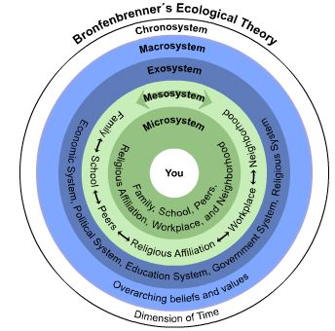
Diagram

Slide 12
Microsystem
Innermost level
Activities, relationships in child’s immediate environment
  Family
  School
  Neighborhood

Slide 13
Mesosystem
Relationships among microsystems
  e.g. relationship between home and school
  e.g. relationship between home and community
Development facilitated by links among microsystems:
  e.g., communication book (home and school)
  e.g., neighbor provides support, shares information about housing (home and community)

Slide 14
Exosystem
Children do not inhabit but affect microsystem
  Parents’ work place
  Health and welfare services

Slide 15
Macrosystem
Overarching values, beliefs, customs, practices
  E.g., Priority given to children’s needs
  E.g., High value placed on education
  E.g., High value placed on teaching and listening

Slide 16
The Family: Outline
Systems perspective
Ecological perspective
Functions: socialization

Slide 17
Functions of the family
Reproduction
Economic services
= goods and services
Social order
= maintaining order, reducing conflict
Emotional support
Socialization

Slide 18
Socialization in the family
Traditional definition: Training young to become competent members of society
My interdisciplinary perspective:
  Parents & others, operating with or without socializing intent, participate in cultural practices with young children
  Young children, as incipient cultural beings & active meaning makers, navigate these practices & make them their own

Slide 19
Socialization:
Interdisciplinary problem
  Language socialization
  Dev cultural psychology
Key: Discursive practices

Slide 20
Socialization:
Happens through everyday talk
Talk is a pervasive feature of family life everywhere in the world
But talk is culturally variable
  kinds of talk that are valued
  how genres are defined and practiced
  how children and others participate

Slide 21
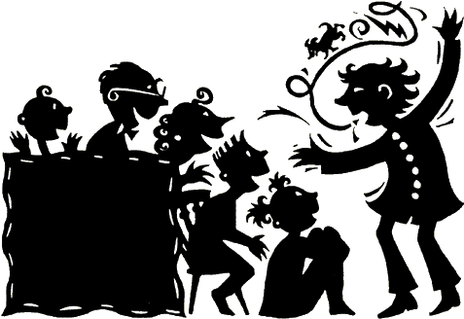
Socialization via narrative practices
Power of narrative:
  Social practice
  Form of representation

Slide 22
Why stories of personal experience?
Universal
Variable
Early

Slide 23
Questions for study:
How is personal storytelling practiced with young children?
How does this practice change over time?

Slide 24
How is personal storytelling practiced? Does it recur?
Why is recurrence so important?
  Routine practices have specific cognitive (+affective, identity) consequences (Vygotsky)
  Early practices become habitualized (Bourdieu)
  Recurrence entails variation

Slide 25
Personal storytelling in Chicago (Longwood) and Taipei
Ethnography + everyday talk
Longitudinal: 2,6; 3,0; 3,6; 4,0
Participants: middle-class, urban, 2-parents
Transcription, emic coding

Slide 26
How was personal storytelling practiced in Taipei and Longwood?
Q1: routinely?
Q2: culturally salient interpretive frameworks?
Q3: children’s participant roles?
Q4: changes in children’s participation?

Slide 27
Q1: Was personal storytelling practiced routinely?

Slide 28
Rates per hour of personal storytelling

Slide 29
Q2: Did personal storytelling carry salient interpretive frameworks?
Taipei: Didactic
Longwood: Child-affirming

Slide 30
Rates of narrated transgressions

Slide 31
Examples of transgression stories
Yoyo (2,6) pushed the screen down and objected when mom punished him
Meimei (3,0) opened a gift, messed up the cake
Didi (4,0) got lost at the night market

Slide 32
Example of early transgression story: Yoyo (2,6) & Grandmother
G: Oh, right. This morning when Mom was spanking you, what did you say? You said, ‘Don’t hit me!’ Right?
Y: Hmn (nods)
G: Then, what did I tell you to say?
Y: ‘I won’t push the screen down.’
G: Oh, right. So, what would you say to Mom?

Slide 33
Yoyo & Grandmother (continued)
Y: I would say to Mom, ‘Don’t have the screen pushed down.’ (Yoyo moves closer and speaks in a very low tone into G’s ear)
G: Oh, you would talk to Mom, saying, ‘Mama, I won’t push the screen down.’
Y: Hmn.
G: So, Mom wouldn’t hit you.

Slide 34
Yoyo & Grandmother (continued)
Y: Hmn.
G: Right? Hmn. If you asked Mom, ‘You don’t hit me,’ Mom would have hit you, right?
Y: Hmn. (nods)
G: So, you would directly say to Mom in this way, ‘Mom, I won’t push the screen down.’ Then how would Mom have reacted?
(continues through 14 more turns)

Slide 35
Child-affirming framework
Omit the negative: child-favorability bias
  Example: Tommy (2,6) started to misbehave but caught himself, he was “real good” and was rewarded
Accentuate the positive
  Child-positive : T and LW but LW inflated
  Humor: LW > T
  Preference: LW > T, inherently +

Slide 36
Example: Child-Affirming + Inflation (Amy, 4,0)
A: “Once there was a fire”…that’s what the policeman told me at day camp.
M: What did he say?
A: He (policeman) tell me to go to the fire department, um the police, to, if you crash, you have to call the policeman.
M: If you cra, what did he say? If you crash?

Slide 37
Amy & Mother (continued)
A: If you crash, you have to call the policeman, right?
M: OK, and when do you call the fire department?
A: When the fire is out, is out.
M: Oh, when there’s a fire?
A: Yeah.

Slide 38
Amy & Mother (continued)
M: So, he would get the fire out, I see. And when would you call an ambulance?
A: When someone is hurt.
M: Exactomundo! (does high five) You are the smartest 4 year old! And there’s the smartest 6 year old and the smartest 2 year old!

Slide 39
Alternative interpretive frameworks
Didactic: consistent with learning as a moral project in the service of self-improvement
(Li, 2003, 2004, 2012)
Child-affirming: consistent with self-esteem ideology and need for positive self-regard
(e.g., Cho et al., 2005; Harwood, Miller & Irizarry, 1995; Heine et al., 1999; Miller et al., 2002)

Slide 40
Q3: What kinds of participant roles did the children enact?

Slide 41
Children’s Participant Roles
Co-narrator role
Bystander role
BOTH roles routinely available
BUT Taipei privileged bystander, Longwood privileged co-narrator

Slide 42
Q4: How did children’s participation change over time?
Continued to listen, Taiwanese children listened more
Contributed more and more creatively to stories

Slide 43
Examples of children creatively co-narrating
“I released the birds by accident” (Yoyo, 3,6)
“Why didn’t you reason with me nicely?” (Angu, 4,0)
“You should’ve watched!” (Amy, 4,0)
“Why do you always say I do wonderful things?” (Patrick, 4,0)

Slide 44
Conclusions:
Socialization is a universal function of families
Socialization begins early in life
Socialization is accomplished through everyday talk, especially personal storytelling
Personal storytelling is culturally constituted from the beginning
Socialization depends on the active participation of family members, including the young child

Slide 45
Conclusions: How personal storytelling was practiced
Q1: routinely? Taipei Longwood
Q2: frameworks? Didactic Affirming
Q3: roles? Bystander Co-Narrator
Q4: changes? Creative Creative
Complex pattern of similarities & differences
Formed alternate socializing pathways
Remarkably stable from 2,6; 3,0; 3,6; 4,0
Children active and became more creative

Slide 46
Back to Recurrence
As children navigate recurring stories, they become more flexible, creative, develop precocity
  Taipei: precocious in the moral domain
  Longwood: precocious in self definition, positive evaluation
As children navigate recurring stories, come to take interpretive biases for granted

